Slide 1




AREA OVERVIEW
DISCOVER, INTERPRET, DELIVER

Slide 2


CONTENIDO
Quiénes somos?
Qué servicios ofrecemos?
Metodología
Diseñamos el mejor camino.

Slide 3
Quiénes somos?

Slide 4
QUIÉNES SOMOS?
MarTech
Director
Christian Ramírez
Digital Products for Business Manager
Fabricio Martínez
Project Managment
x4
Analytics Lead
Laura Correa
DEV Lead
Sergio Ferro
UX-CM Lead
Alejandro Urueña
CM – x5
UX – x9
BACK – x4
FRONT – x4
QA
ARCHITECT
Angela Galvis
Johann Susa
Juan Pablo Vargas
Francisco Mahecha

Slide 5
Qué servicios ofrecemos?

Slide 6
NUESTROS SERVICIOS
Dev
Dev Analysis
Functionality
Integrations
Cm
Exploration/Research
Strategy
Implementation
E2E
Ux
Exploration/Research
Service Design
Wireframes
UI/Prototype
Testing

Slide 7
Metodología

Slide 8

Comités Arquitectura
Entregables
Aprobaciones
ARB1
ARB2
ARB3
14 DEV
2 Ux
1 Ui
4 CM
1 ARQ
8 QA
9 PM
T2BAU
Service Owner
Quantitative research
Usability testing
User personas & scenarios
Market segmentation

Slide 9
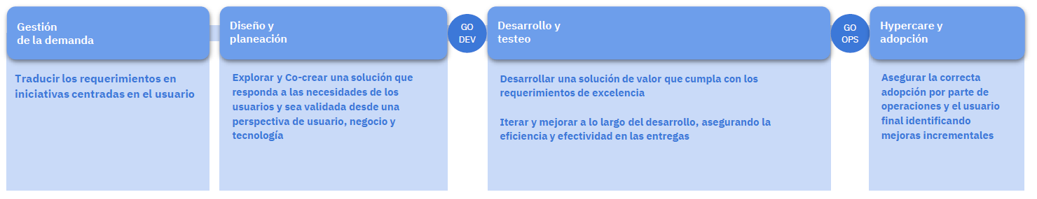
Quantitative research
Usability testing
User personas & scenarios
Market segmentation

Slide 10

AREA OVERVIEW
DISCOVER, INTERPRET, DELIVER

